Slide 1

Athena Project Progress Report
Yufei Gu Jie Gao Jikun Lu
April 27th 2023

Slide 2
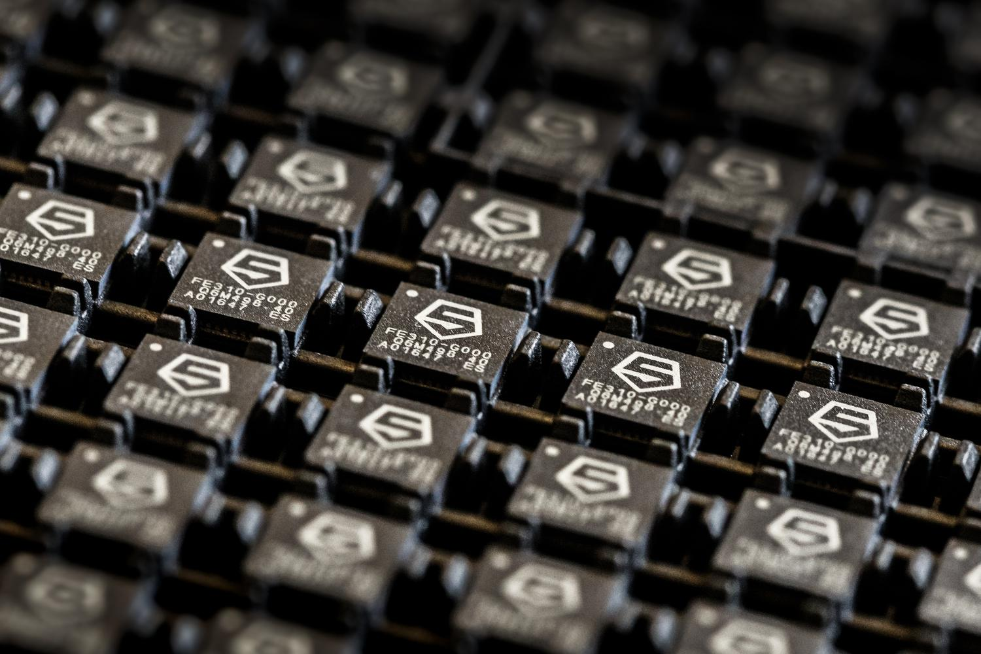
The Goal of our Athena Project
The goal of the Athena project is to design a microcontroller based on Sifive's RISC-V FE310 processor.
The microcontroller will replace the original development board in the undergraduate course ELEC220 at Rice University.
This development board needs to be as compact as possible and able to be powered by external batteries for instructional use.
This development board needs to support JTAG, I2C, and SPI interface protocols to enable support for more external devices.

Slide 3
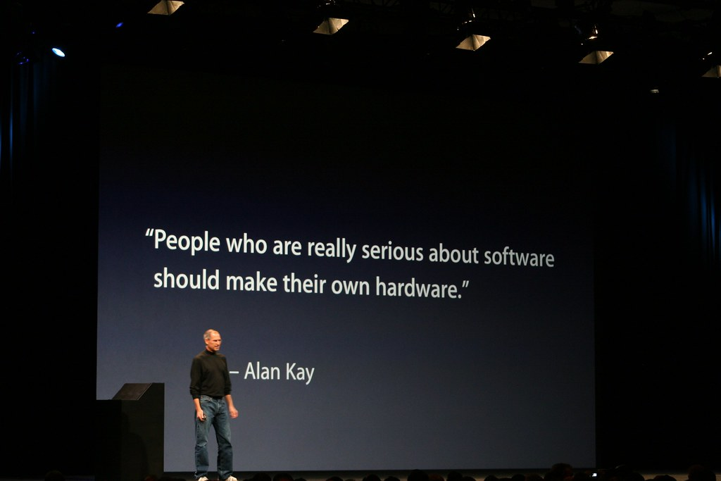
Design and reference from predecessors.
The work of our predecessors
SiFive's official website has the reference design for the FE310 development board.
The Jennifer group previously designed a development board with similar functionality, but it was not assembled or tested.
Our idea
Because we are not familiar with the Eagle PCB software used by the Jennifer group for designing the PCB, we decided to refer to SiFive's reference design and create our own hardware design. Additionally, we value software and want to create our own hardware

Slide 4
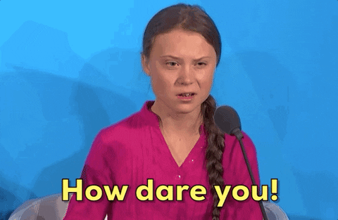
What we can improve in our project
SiFive uses Segger's J-Link product, and if we use Segger's J-Link in our design, it will require a commercial license fee, which can cost thousands of dollars.
Using a local supplier can help us prototype PCBs, but the prices are outrageous - getting samples within 2 weeks costs over $2000
We want to spend our budget on something more meaningful

Slide 5

We have made the following improvements.
We noticed that one of SiFive's discontinued development board used FTDI's FT2232HL as a debugger, which can be used as an alternative to Segger's J-link. We think it's worth a try.
Since our team member Yufei Gu has experience in assembling PCBs, we have decided to use JLCPCB, a PCB supplier from China, to manufacture our PCBs. We will assemble them ourselves, which will not only allow us to conveniently debug and ensure that there are no issues caused by assembly, but also significantly reduce the development cost.
We replaced Micro USB with USB Type-C to increase universality, but we still use the USB 2.0 protocol.

Slide 6
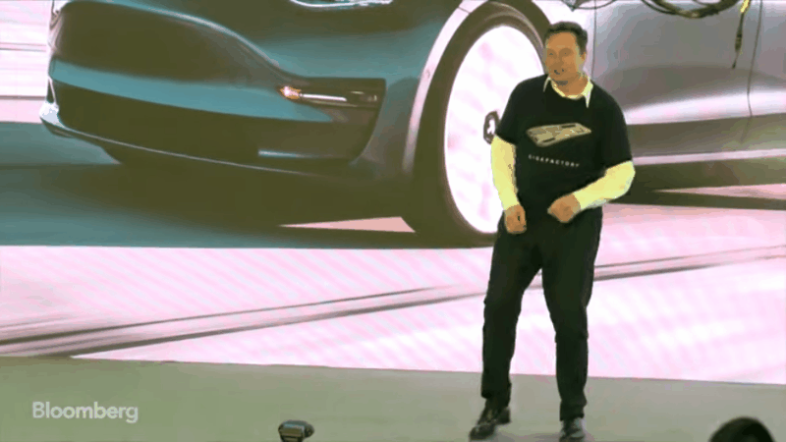
Thank you FTDI

Slide 7
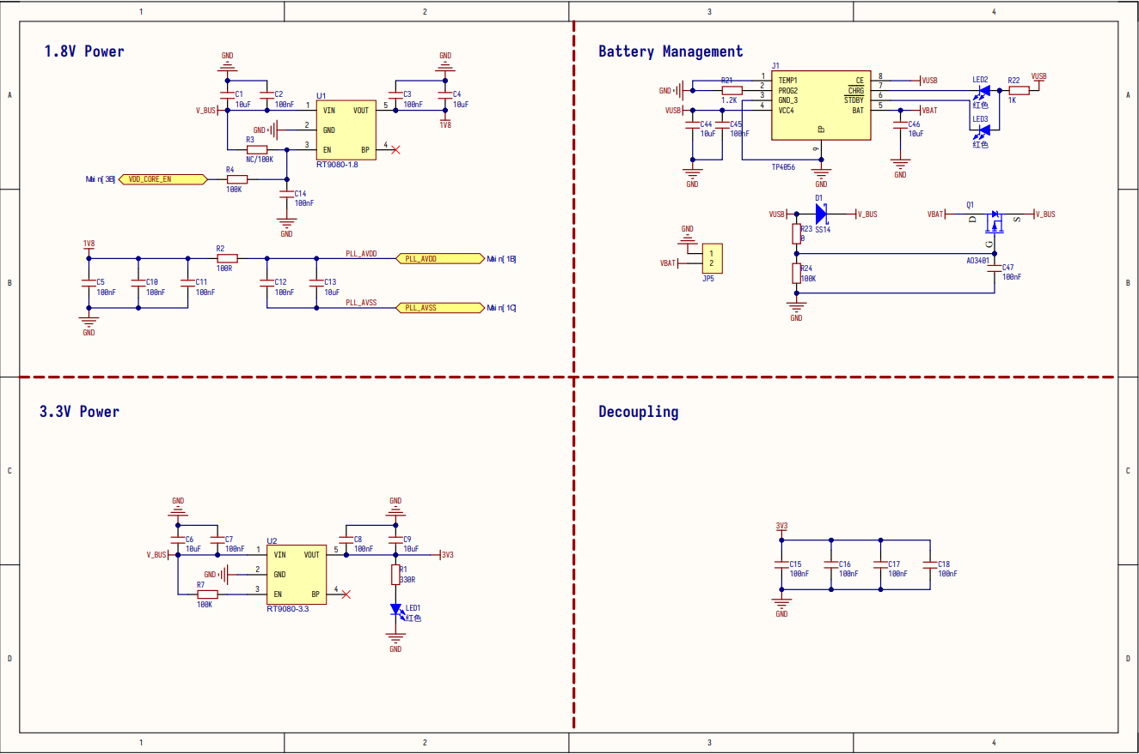
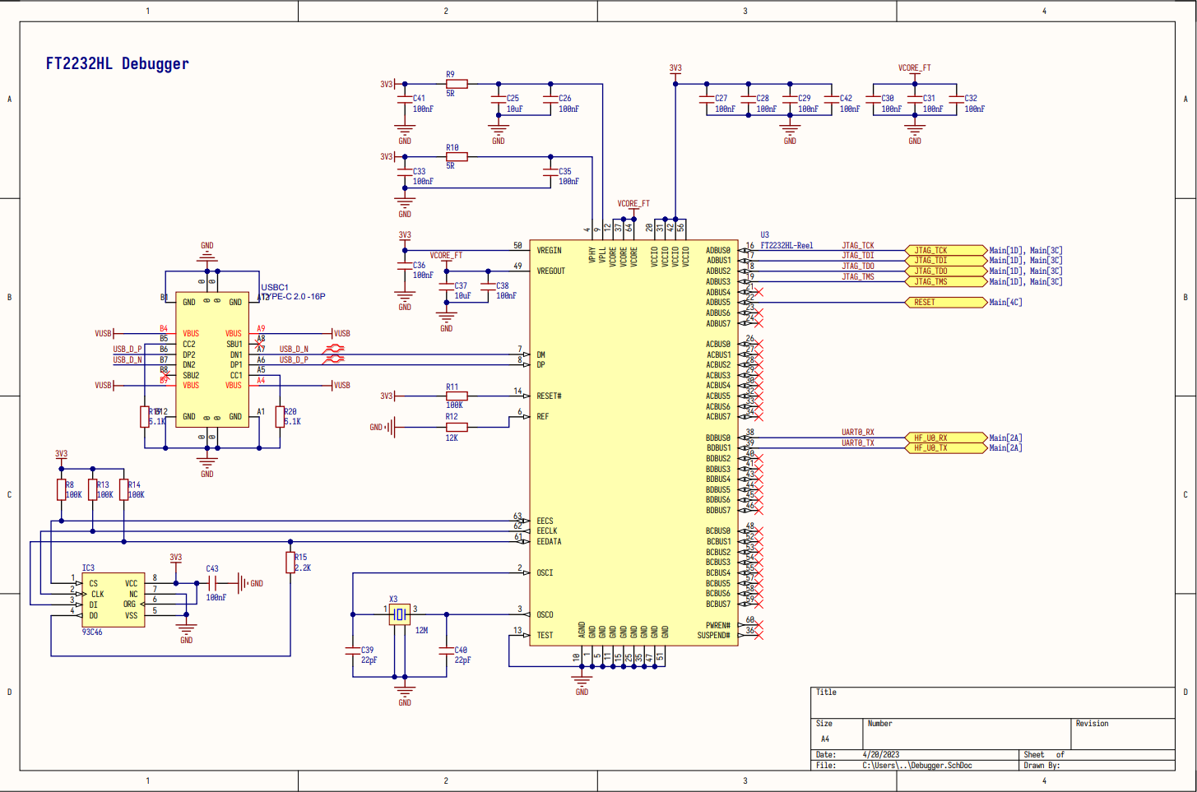
Our schematic design(Power supply and debugger.)

Slide 8
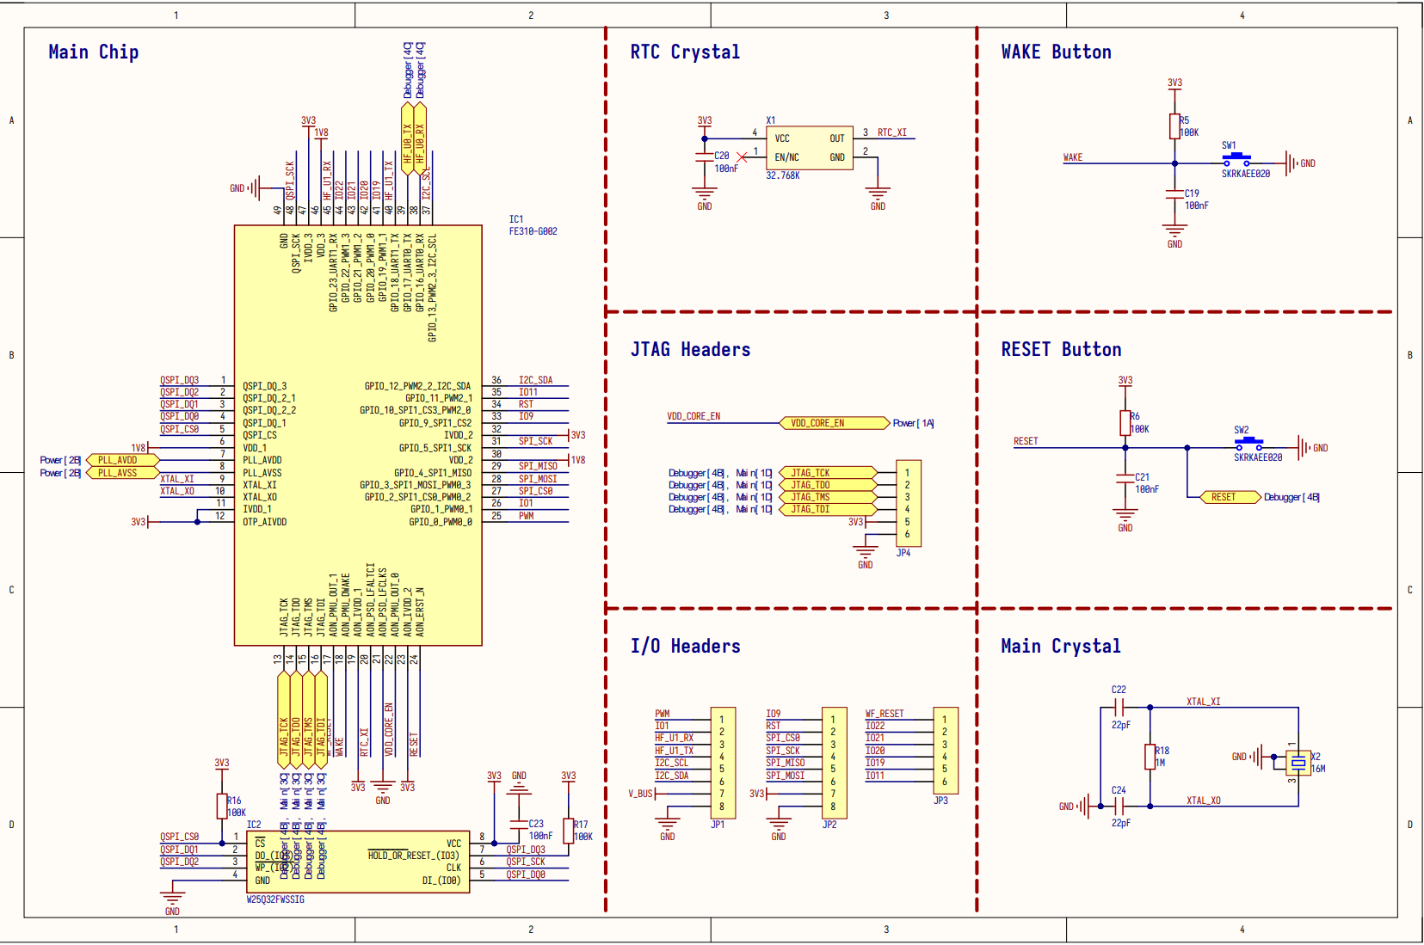
Our schematic design(SiFive EF310-G002)

Slide 9
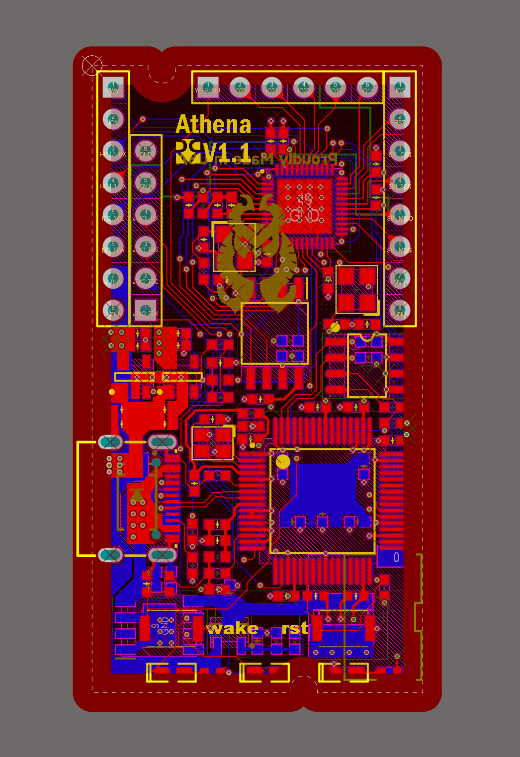
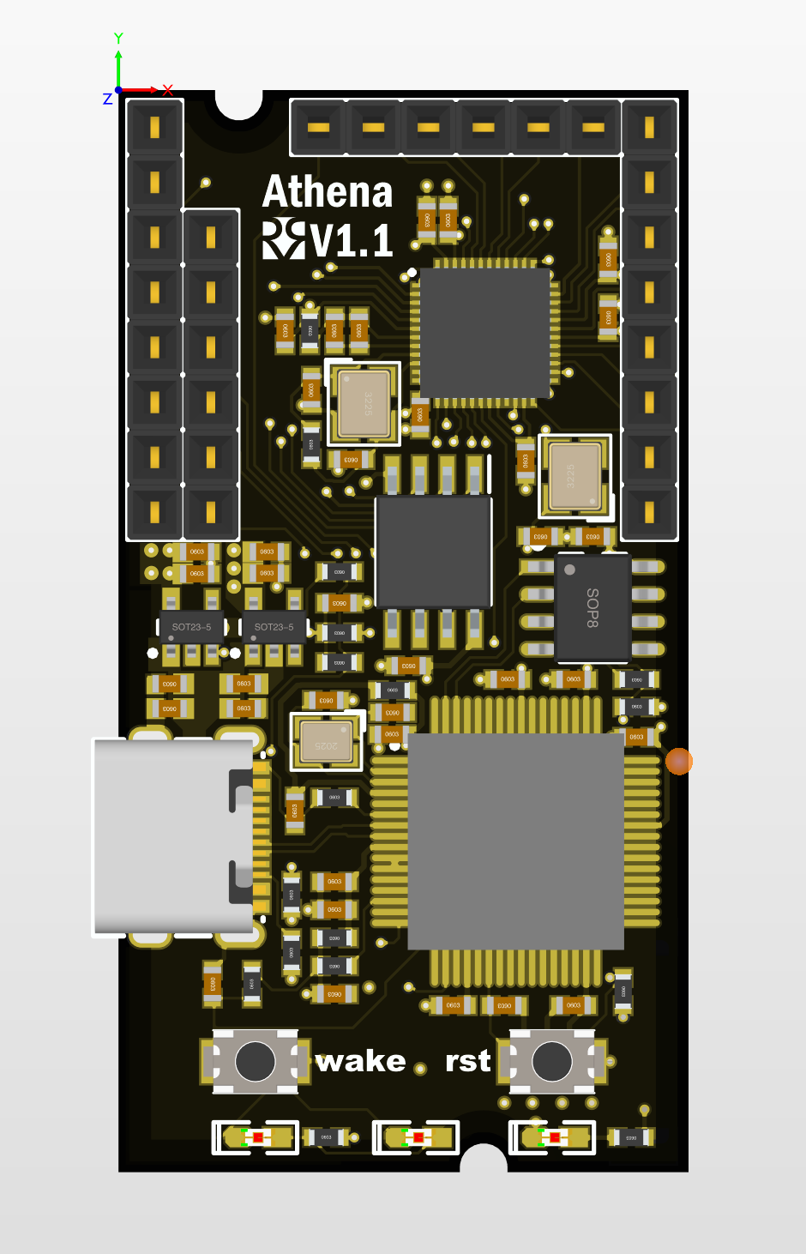
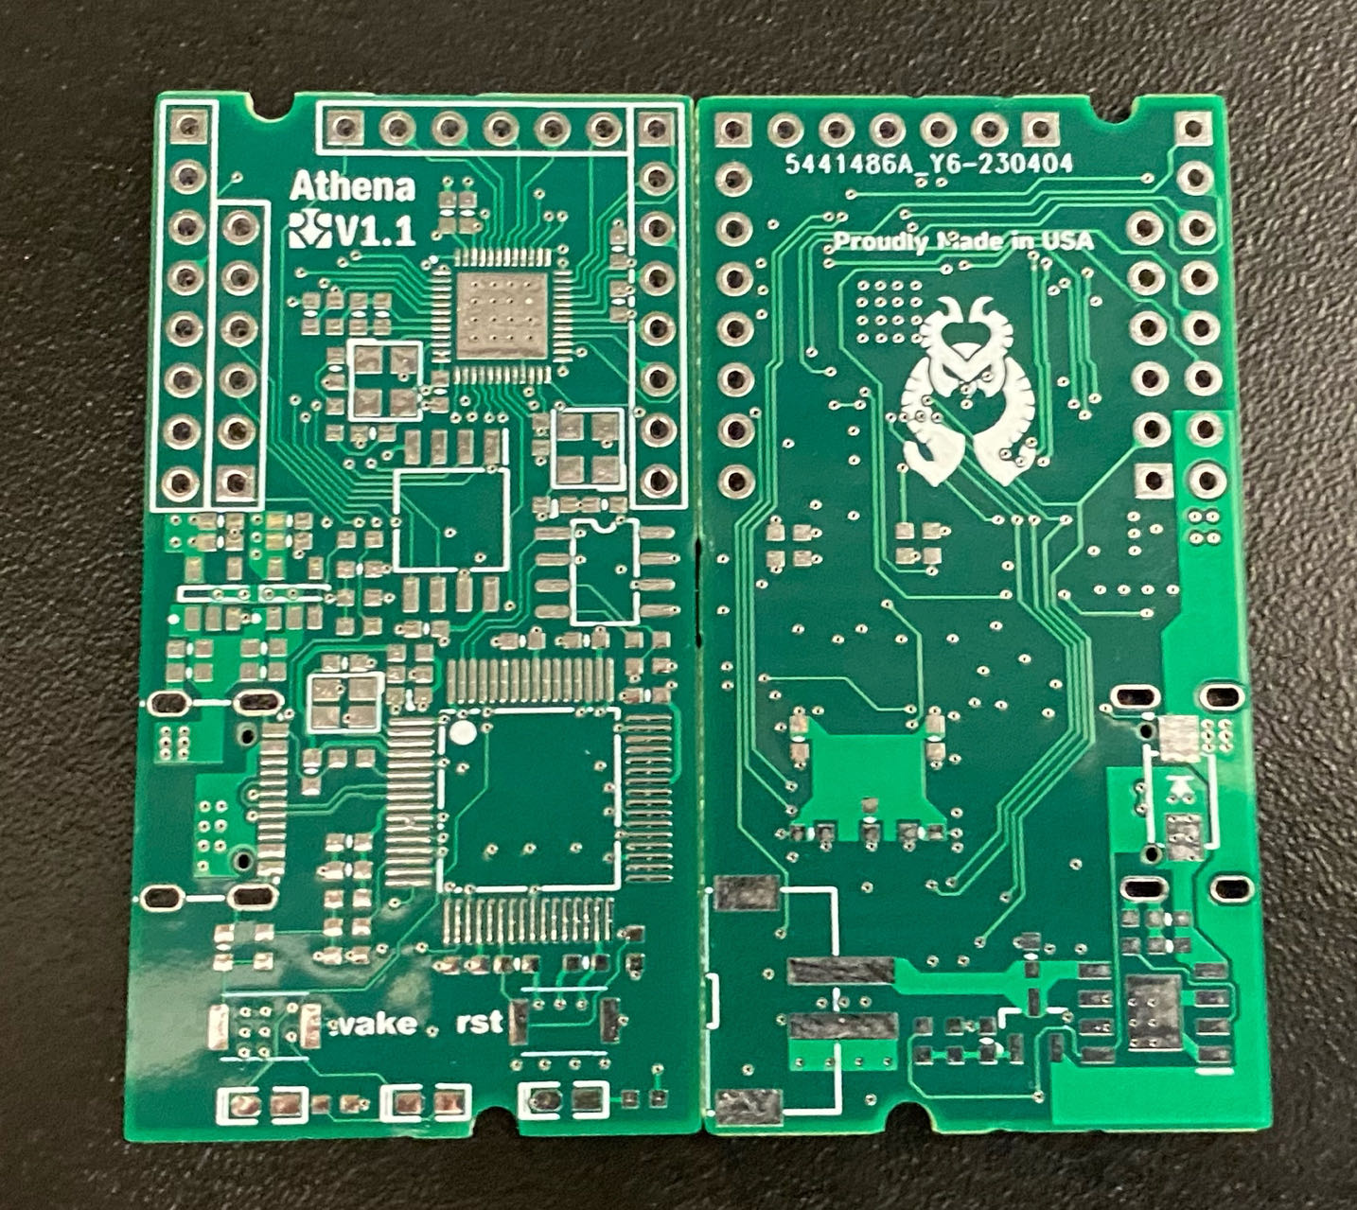
PCB Design (4-layer-board)

Slide 10
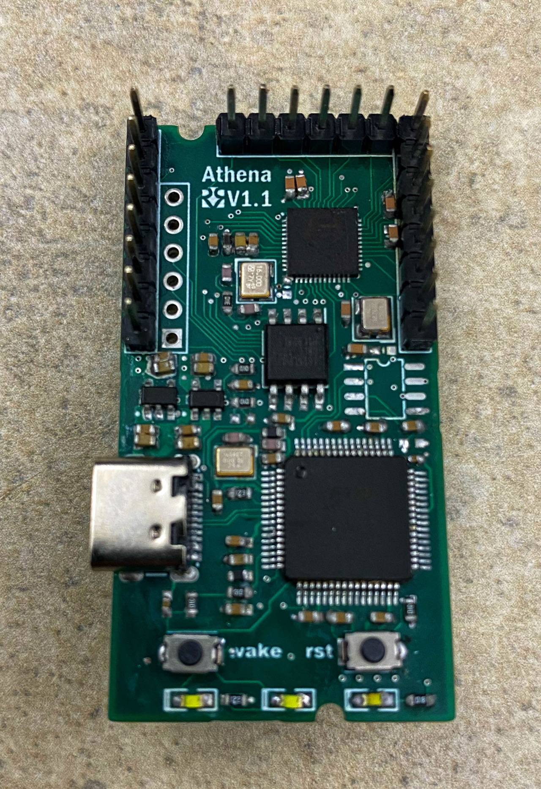
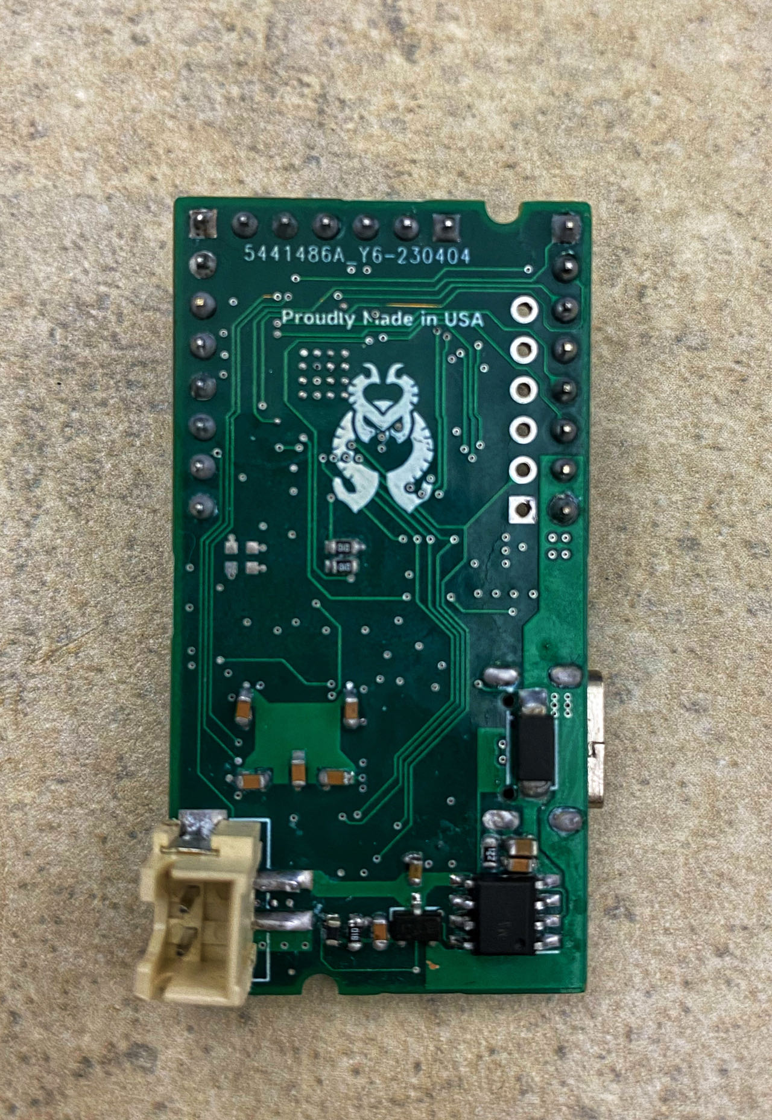
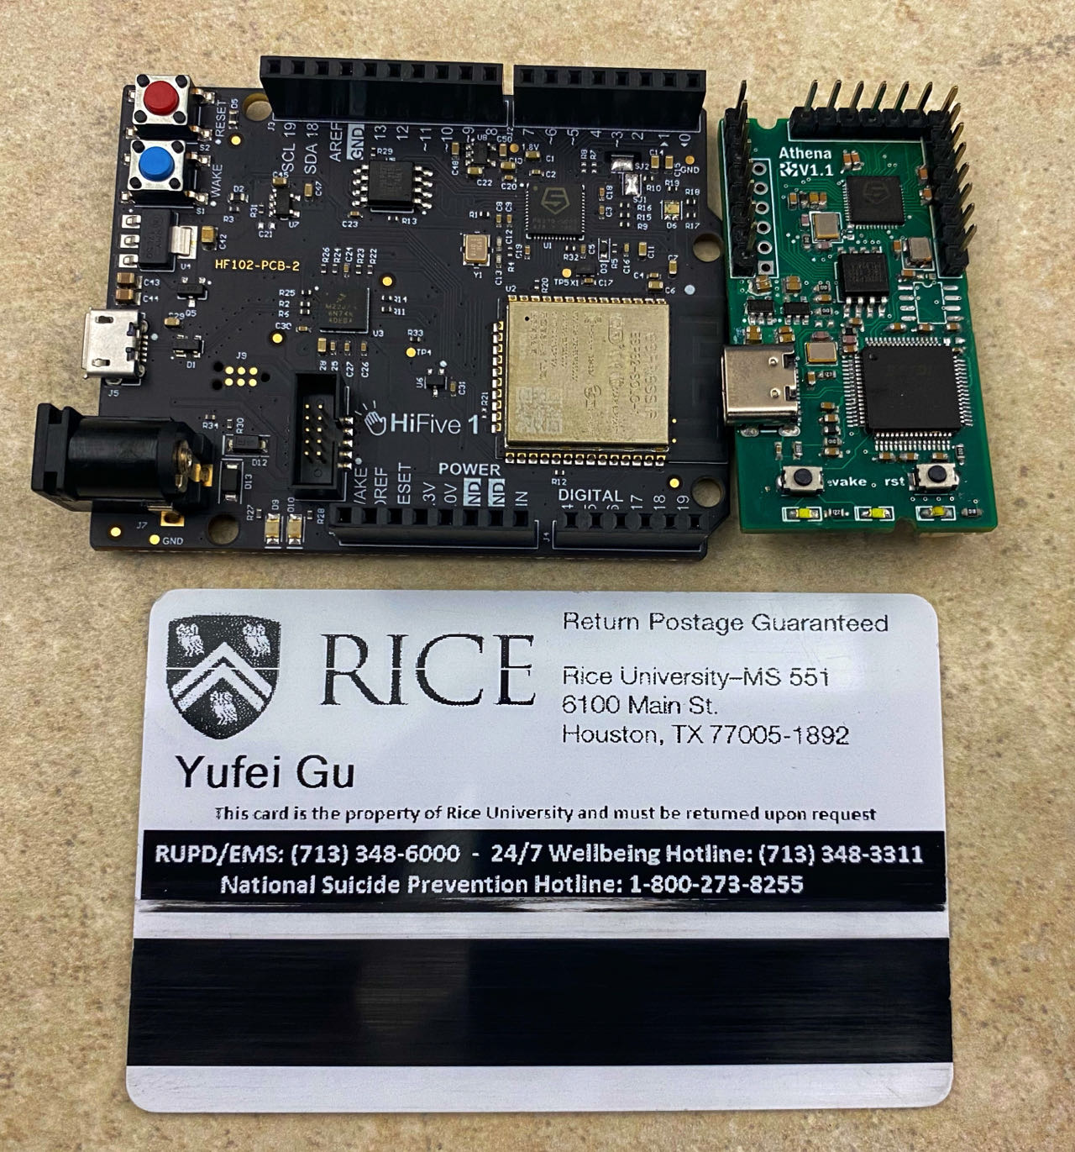
Final Work (Rev 1.1)

Slide 11
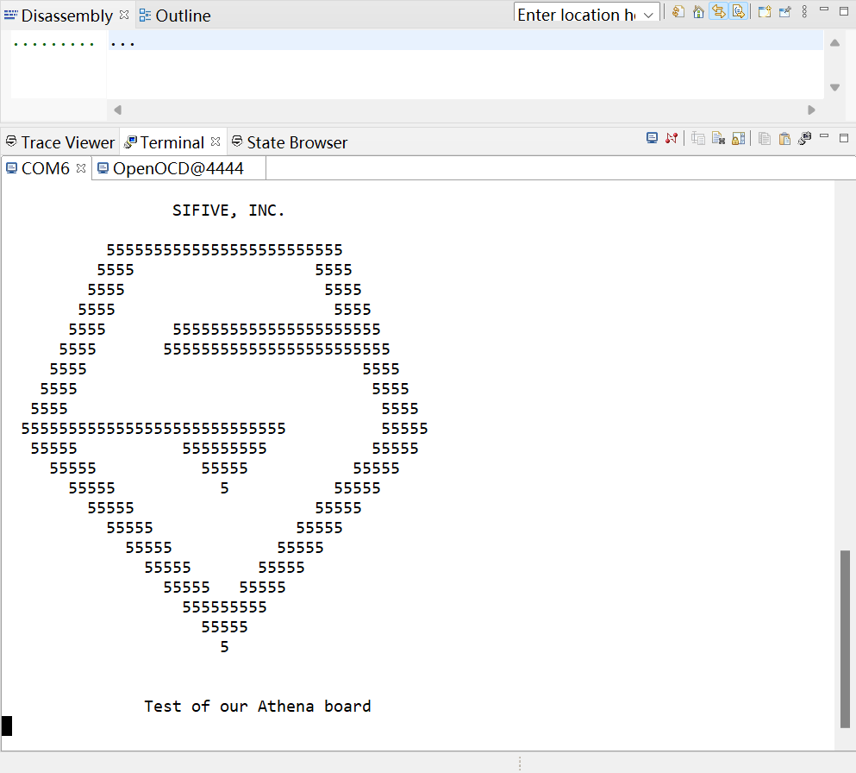
Does it work?
For FE310 G002, it works in Freedom Studio But it needs to modify the configuration file.
FE310 G002 comes from the SiFive development board.
There is a difference in the memory address settings between FE310 G000 and G002, so we made modifications to the configuration file. The modified file can be found in our GitHub project.
After modifying the configuration file, FE310 G002 can be programmed through JTAG.

Slide 12
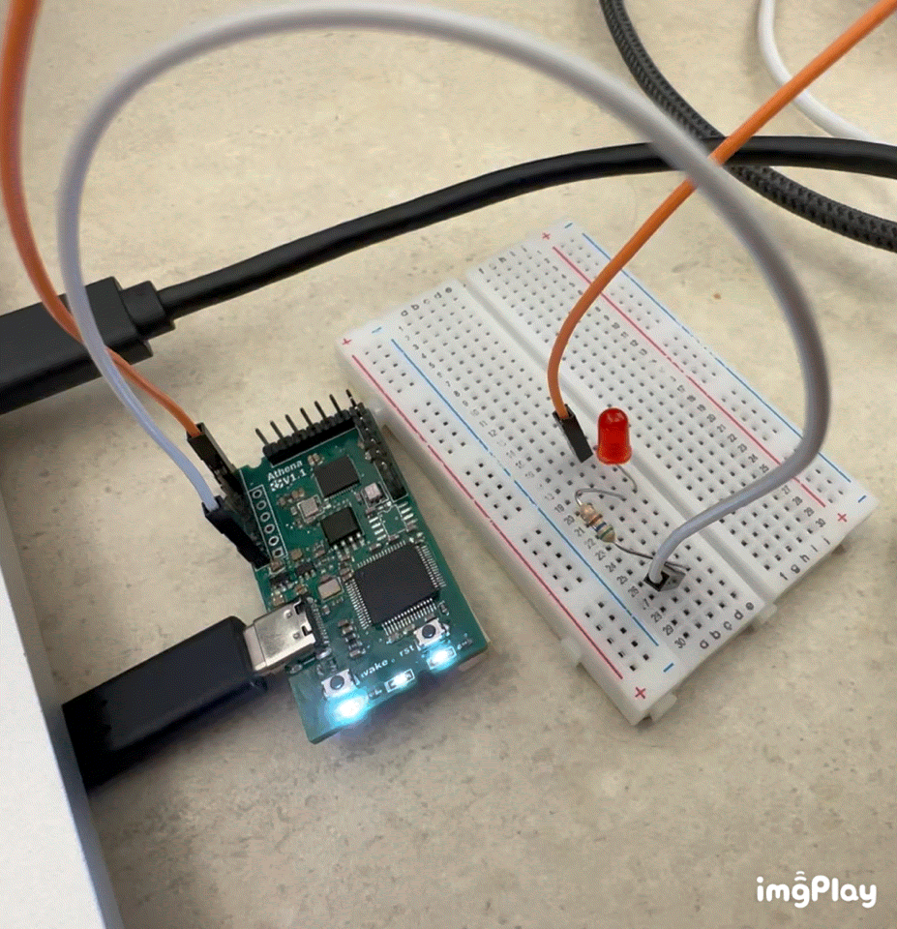
Demonstrate LED blinking using Athena board.

Slide 13
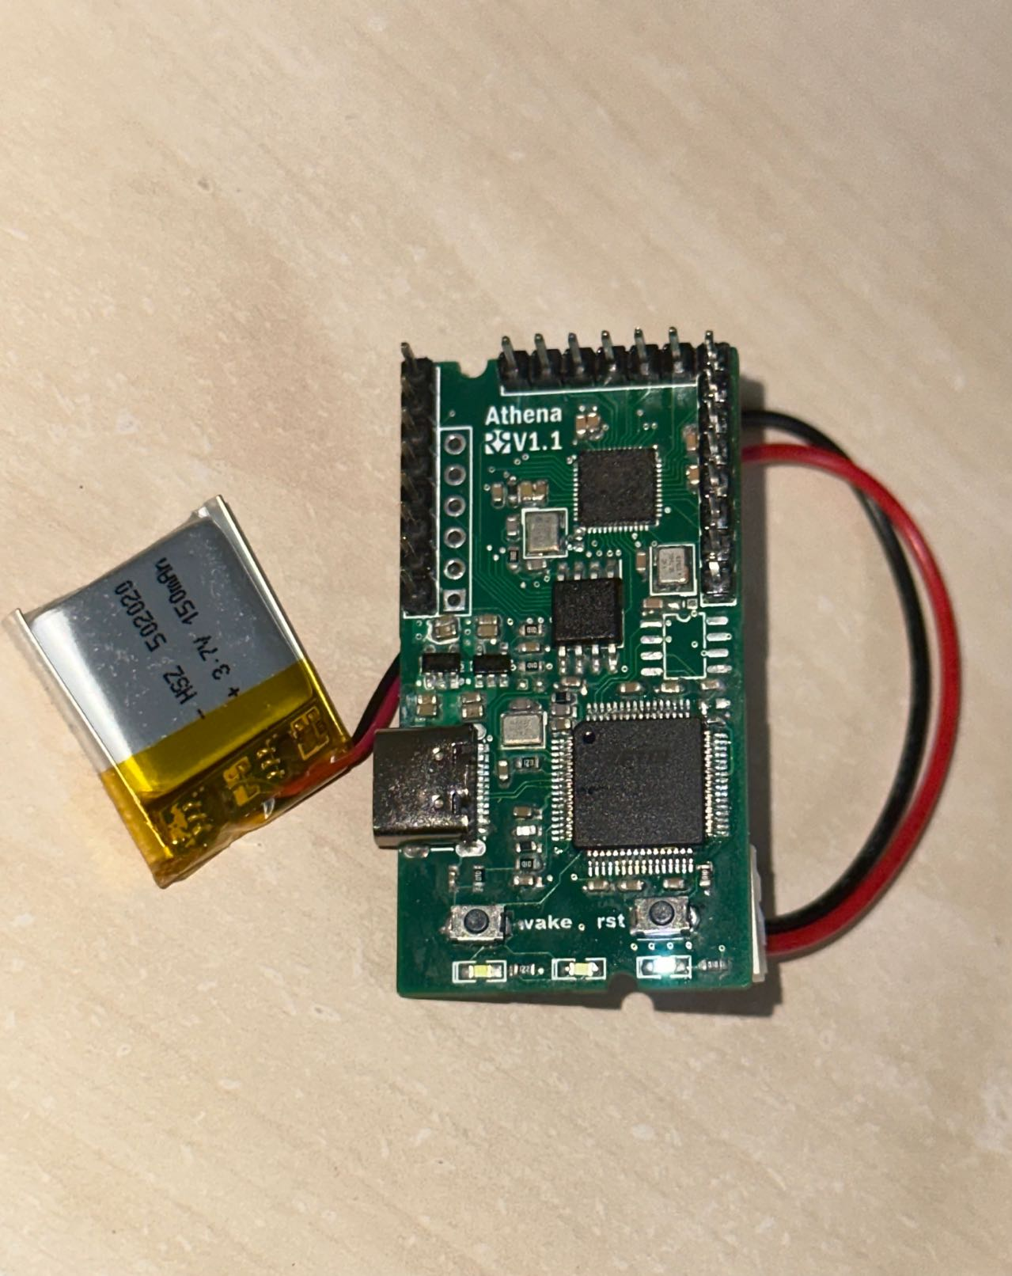
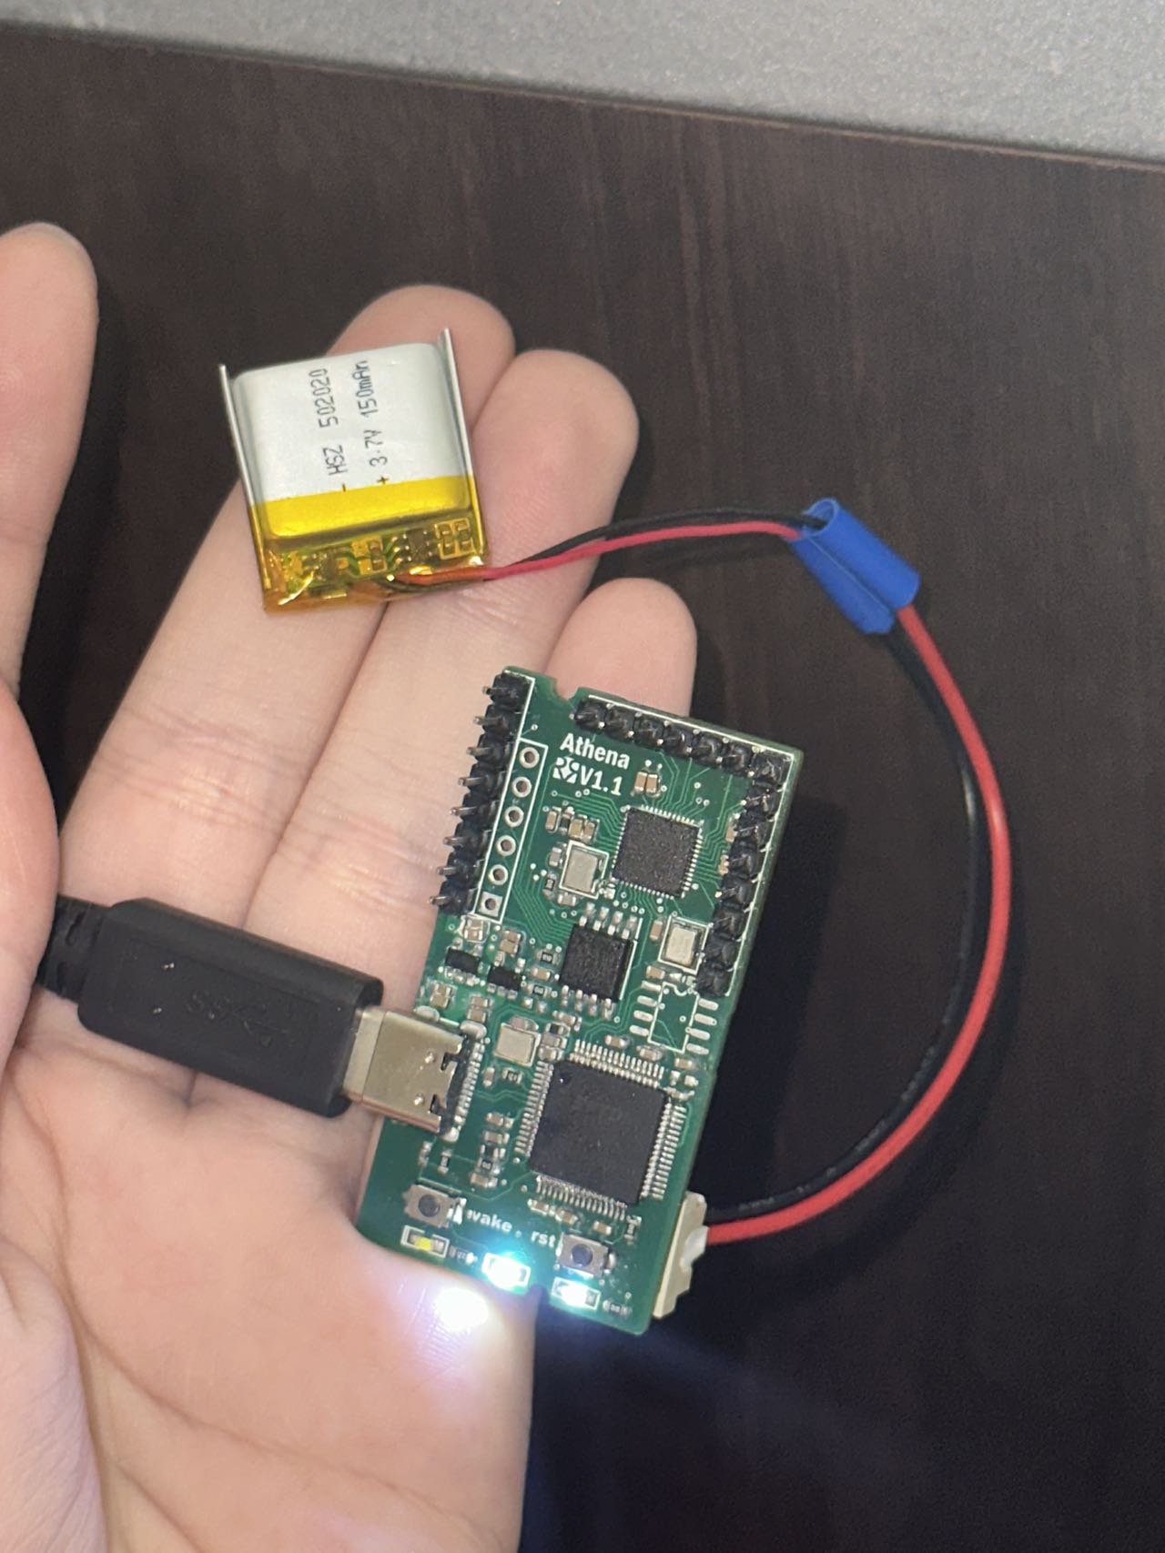
It can support external battery charging and discharging.
After our testing, we have confirmed that our design can support both battery charging and power supply functions.
The pictures represent the external battery power supply mode and external battery charging mode.

Slide 14

The cost of our design
Due to the elimination of the cost of using local suppliers to assemble PCBs and the cost of licensing Segger's J-link, we have greatly saved on development costs.
Our material cost can be divided into the following items(Without shipping):
JLCPCB sample prototyping 14$
Order from LCSC 224.64$
Order from Digikey 285.93$
The total cost is 524.57$

Slide 15
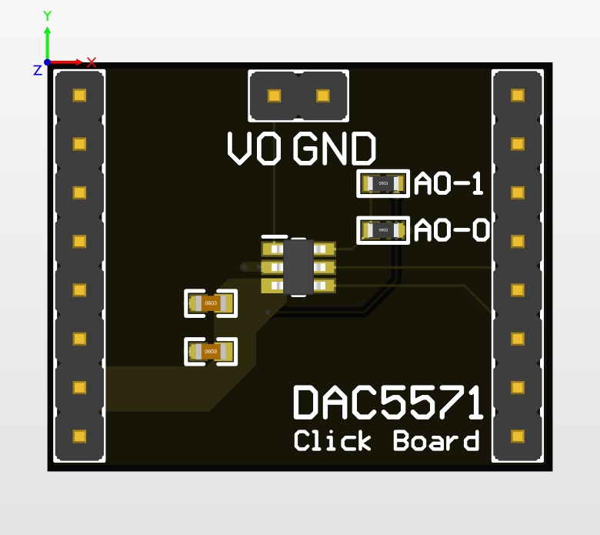
Future work
Our design is compact and supports the external power supply, but we think it can be improved in the following areas.
Adding pull-down resistors on USB CC1 and CC2 to enhance Type-C to Type-C port compatibility/support.
Adding a switch to extend the power supply time when using external battery power.
Pull out the UART interface to headpins for debugging.
Design more click boards for support
DAC click board

Slide 16
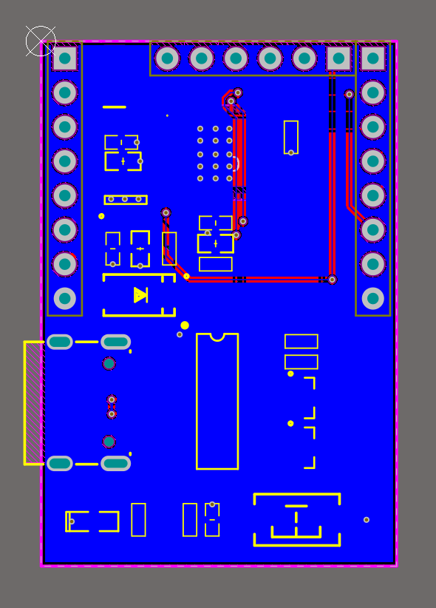
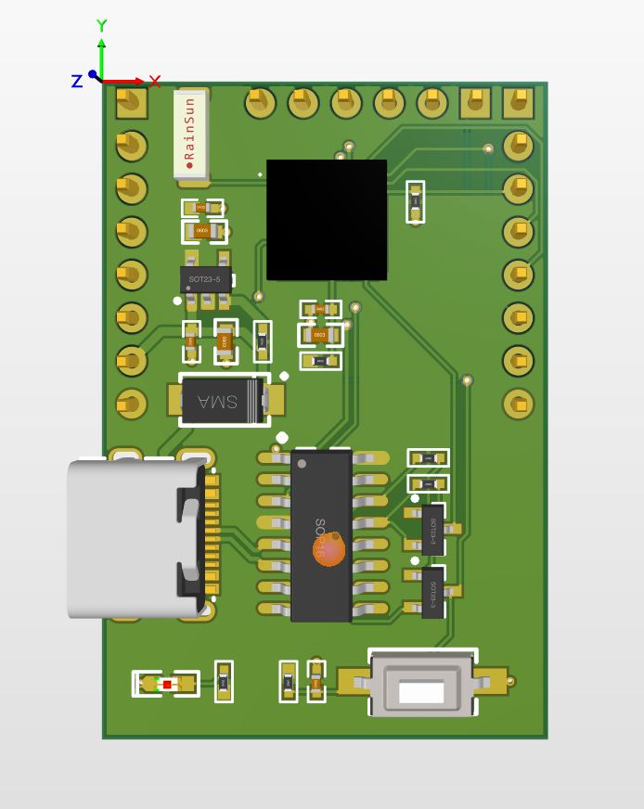
Our Idea of ESP32 click board (Wifi support)

Slide 17
Any Questions

